Slide 1
PREDICTING FLIGHT DELAY DURING TAKE-OFF
Harshvardhan Surolia 01FB16ECS408
Manmath Sahoo 01FB16ECS488
Team: DATA DUO

Slide 2
CONTRIBUTION
HARSHVARDHAN SUROLIA
Data Cleaning.
Understanding working of Polynomial Regression.
Statistics about airlines.
Making model 1 ( One airline, all origin airport).
Manmath Sahoo
Understanding of the dataset, meaning of attributes.
Use of regularization to prevent over-fitting.
Making model 2(One airline, all origin-destination pair).

Slide 3
Explanation of dataset and importance of problem
The dataset was downloaded from Kaggle, it has 3 csv files namely airlines.csv, flights.csv, airports.csv .
flights.csv has data about different flight carrier, origin and destination airports also the delay and the cause of the delay associated with the flight. It has 31 attributes and around 58 lakhs datapoints.
airlines.csv has the name of the airline carrier and the IATA code it has 14 datapoints.
airports.csv has the name of the airport, location of the airport. It has 322 datapoints and 7 attributes.

Slide 4
Importance of problem
In the past few years there has been an increase in the number of people travelling by flights due to cheaper rates and large number of flights available.
Due to large number of flights and less number of airports there has been an increase in the air traffic which lead to large amount of delays.
So it is necessary for the flight companies to predict delays accurately so that they can organise their flights efficiently and also provide a better experience to their customers.

Slide 5
Approach used
So to solve this problem we decided to stick to regression as it is easy to understand and doesn’t require a lot of understanding unlike many other machine learning algorithm also it is easier to see the fixed and variable components with regression.
We trained our model using simple linear regression and polynomial regression, to prevent overfitting we also did L2 regularization.
To reduce computational time we took data for January only.
We divided the dataset into training and testing , training has the data for the first 3 weeks and testing has the data for the last 3 weeks.
To validate our model we are using rmse value.

Slide 6
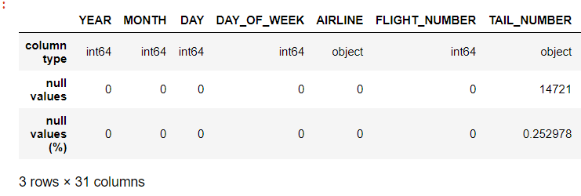
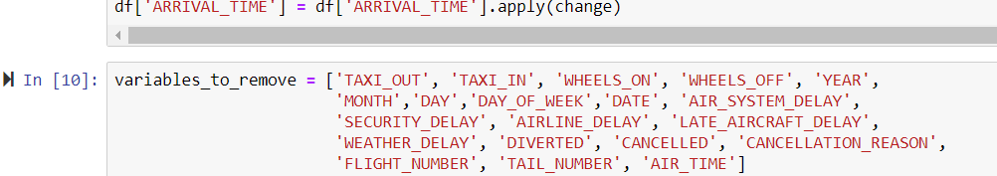
Cleaning of data
Cleaning involved changing the type of attributes , dropping attributes that have misleading values, and dealing with null values.
We can see that YEAR, MONTH,DAY are of type int
so we combine them into one attribute DATE which is of
type datetime.
Attributes like ARRIVAL_TIME ,DEPARTURE_TIME had misleading values so we removed those attributes
After that we removed the attributes that
was of no use for our project. The figure shows the
Variables that were removed.

Slide 7
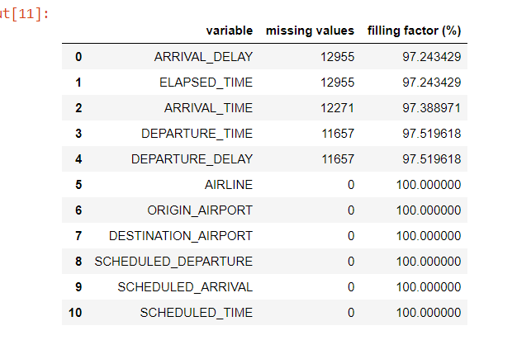
Null values
After having the required attribute the next step was to deal with null values.
So before doing any kind of imputation we see how complete our dataset is, for this we obtained filling factor for each attribute.
From the image shown we can saw that the dataset is
quite complete the filling factor is approximately 97%
so instead of doing imputation we just dropped null values
as there will be no significant loss.

Slide 8
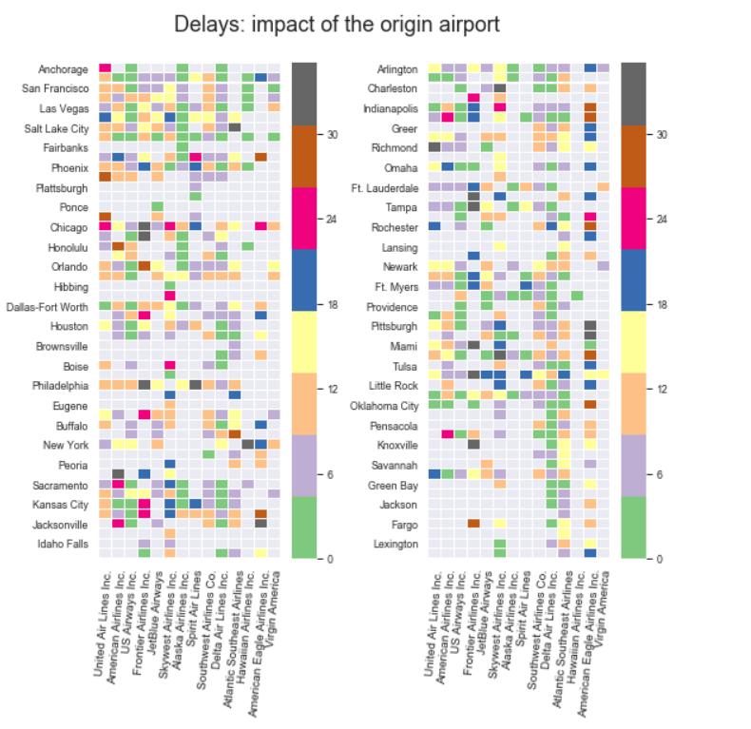
The heatmap shown tells us that there is a lot of variation in delays both between origin airports and different airline carrier, so we can’t just say that one model that works for one airline will work for all the other airlines so the model will be company specific.
Here we are considering American Airlines as it is the largest carrier in the US and also it has recorded some larger delays.

Slide 9
Model
We have trained two models :
Model 1 (one airline and all origin airports)
We divided the training dataset into training and validate so that we can get optimum value of parameters for polynomial regression.
We trained our model using simple linear regression we got an rmse value of 8.25 min, to improve the model we implemented polynomial regression, when we validate our model we got an rmse value of 21889.43, the rmse value is quite high this is because the model is overfitting so to prevent this we perform L2 regularization.
After performing regularization we tried predicting the value of alpha and n(degree) for polynomial regression we got the following values alpha=0.8 and n=1 and the model gave a rmse value of 7.53 min.

Slide 10
Model 2 (One airline and all origin-destination pair)
We followed a very similar approach as in the previous model but this time we accounted for the destination as well.
Simple linear regression gives a rmse value of 8.77 and polynomial regression we got the following value : alpha = 0.4 , n=1 and rmse value is 9.46 min .

Slide 11
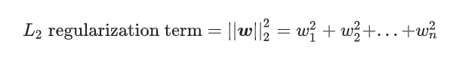
L2 Regularization
Use to prevent overfitting
its adds "squared magnitude” of coefficient as penalty term to the loss function.
Equation is

Slide 12
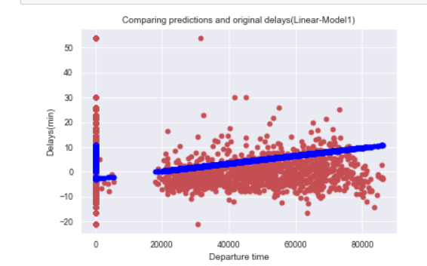
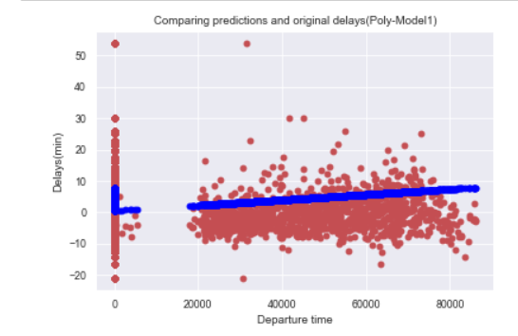
Predictions (Results)
When predicting the value for last week of January using model one we got the following results:
Simple linear regression : Rmse value is 7.81
Polynomial regression : Rmse values is 7.61

Slide 13
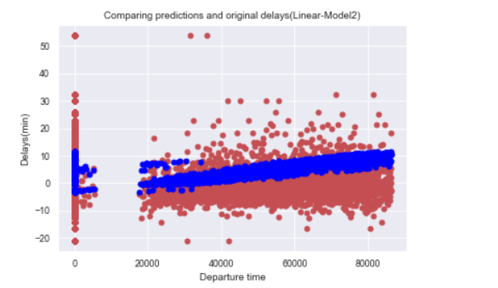
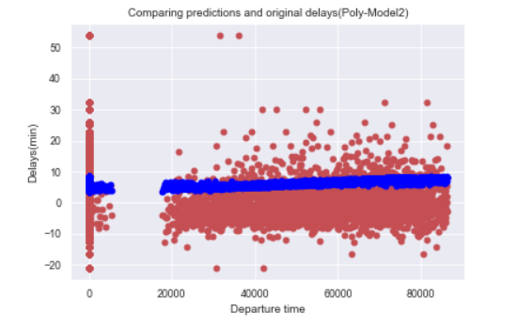
When predicting the value for last week of January using model one we got the following results:
Simple linear regression: Rmse value is 7.95
Polynomial regression : Rmse value is 8.63

Slide 14
Conclusion
We got a very similar prediction using both the model and for both the techniques this is because the dataset has a large number of small delays and small number of large delays, so both of our model does a very similar .
Our model performs well in predicting delays within the range 0-15 min
To improve the accuracy of our model we can do clustering and for each of the cluster we can have a appropriate model, this is something we will like to work on in future.

